Slide 1
Data Structures
_{Lecture 5: Tree}

Slide 2
Tree
We see tree in nature. The tree has root, branches, sub-branches and leaves. From the concept of natural tree, the computer scientists get the idea of a data structure, which is graphically similar to natural tree.
Natural tree is a bottom-up figure. However, the graphical representation of the data structure tree is a top-down figure

Slide 3
Tree Data Structures
A graph which has no cycle is called an acyclic graph. A tree is an acyclic graph or graph having no cycles.
Trees are mainly used to represent data containing a hierarchical
relationship between elements, for example, records, family trees and
table of contents.
• Consider a parent-child relationship
Mohammad Aslam Khan
Sohail Aslam
Javed Aslam
Yasmeen Aslam
Haaris
Saad
Qasim
Asim
Fahd
Ahmad
Sara
Omer

Slide 4
Common use of Tree data structure
hierarchical system or organization is one in which people have different ranks or positions, depending on how important they are.
Storing data in a way that makes it easily searchable
Representing sorted lists of data
As a workflow for compositing digital images for visual effects. Used in almost every 3D video game to determine what objects need to be
rendered.
Routing algorithm. Used in almost every high-bandwidth router for storing router-tables.
Directory structure of a file store
used in compression algorithms, such as those used by the .jpeg and .mp3 file-formats.

Slide 5
Characteristics of trees
Non-linear data structure
Searching as fast as in ordered array
Insertion and deletion as fast as in linked list
Simple and fast
A tree can be implemented (stored in memory) as an array or a linked list.

Slide 6
Tree Data Structures
hierarchical system or organization is one in which people have different ranks or positions, depending on how important they are.
A tree is an acyclic graph or graph having no cycles.
A tree is an abstract model of a hierarchical structure that consists of nodes with a parent-child relationship.
• Tree is a sequence of nodes
• There is a starting node known as a root node
• Every node other than the root has a parent node.
• Nodes may have any number of children

Slide 7
Tree Data Structure:
A
B
C
D
E
F
G
H
I

Slide 8
Not a Tree
Structures that are not trees.
A
B
C
D
E
F
G
H
I

Slide 9
Not a Tree
Structures that are not trees.
A
B
C
D
E
F
G
H
I

Slide 10
Not a Tree
Structures that are not trees.
A
B
C
D
E
F
G
H
I

Slide 11
Some Key Terms:
• Root − Node at the top of the tree is called root.
• Parent − Any node except root node has one edge upward to a node called parent.
• Child − Node below a given node connected by its edge downward is called its child node.
• Sibling – Child of same node are called siblings
• Leaf − Node which does not have any child node is called leaf node.
• Sub tree −Subtree of a node is defined as a tree which is a child of a node. The name emphasizes that everything which is a descendant of a tree node is a tree too, and is a subset of the larger tree.
• Levels − Level of a node represents the generation of a node. If root node is at level 0, then its next child node
is at level 1, its grandchild is at level 2 and so on.
• keys − Key represents a value of a node based on which a search operation is to be carried out for a node.

Slide 12
Parts of a Tree

Slide 13
Parts of a Tree
nodes

Slide 14
Parts of a Tree
parent node

Slide 15
Parts of a Tree
parent node
child nodes

Slide 16
Parts of a Tree
parent node
child nodes

Slide 17
Parts of a Tree
root node

Slide 18
Parts of a Tree
leaf nodes

Slide 19
Parts of a Tree
Left sub-tree

Slide 20
Parts of a Tree
Parent
Right sub-tree

Slide 21
Parts of a Tree
sub-tree
Parent

Slide 22
Parts of a Tree
Parent
sub-tree

Slide 23
m-array Trees A Tree is an m-array Tree when each of its node has no more than m children.
a
d
64
b
c
e
56
89
g
i
f
h
j
k
47
59
l
m
n
o
p
Three-array trees
(m=3)
Two-array trees
(m=2)

Slide 24
Binary Tree (BT)
Each node can have at most 2 children

Slide 25
Binary Tree
Binary tree with 9 nodes.
A
B
C
D
E
F
G
H
I

Slide 26
Binary Tree
root
A
B
C
D
E
F
G
H
I
Left subtree
Right subtree

Slide 27
Binary Tree
Recursive definition
A
root
B
C
D
E
F
Left subtree
G
H
I
Right subtree

Slide 28
Binary Tree
Recursive definition
A
B
C
root
D
E
F
G
H
I
Left subtree

Slide 29
Binary Tree
Recursive definition
A
B
C
D
E
F
root
G
H
I

Slide 30
Binary Tree
Recursive definition
A
root
B
C
D
E
F
G
H
I
Right subtree

Slide 31
Binary Tree
Recursive definition
A
B
C
root
D
E
F
G
H
I
Left subtree
Right subtree

Slide 32
Level & Depth of a Binary Tree
The level of a node in a binary tree is defined as follows:
Root has level 0,
Level of any other node is one more than the level its parent (father).
The depth of a tree means how many levels is in the tree i.e. the Total number of level in the tree.

Slide 33
Level of a Binary Tree Node
Depth =3
A
0
Level 0
B
1
C
1
Level 1
D
E
F
2
Level 2
2
2
G
H
3
I
3
Level 3
3

Slide 34
Height
Total number of edges that lies on the longest path from any leaf node to a particular node is called as height of that node.
Height of a tree is the height of root node.
Height of all leaf nodes = 0

Slide 35
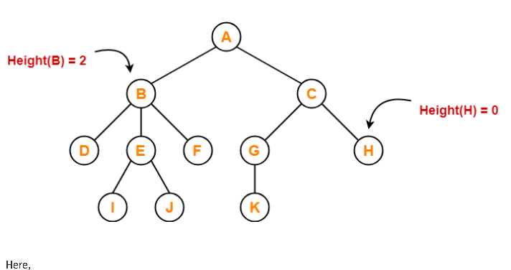
Height

Slide 36
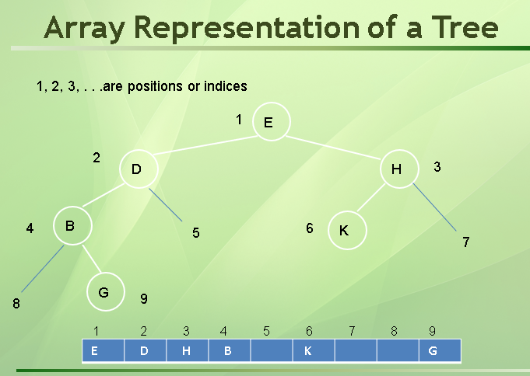

Slide 37
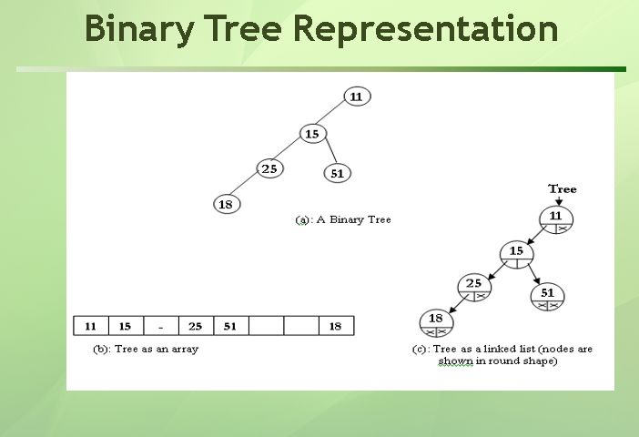

Slide 38
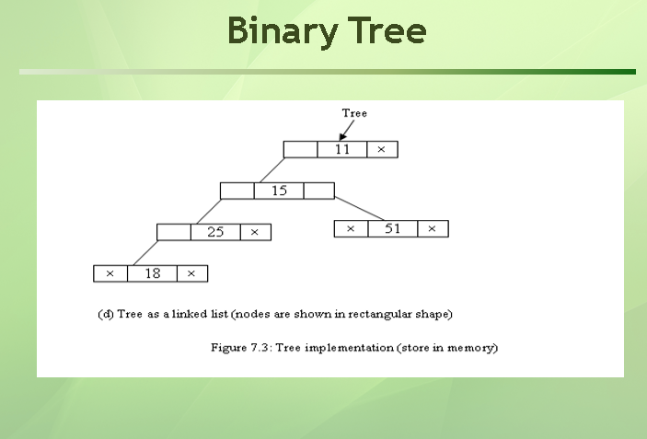

Slide 39
Types of Binary Tree
1. Full Binary Tree 2. Complete Binary Tree 3. Skewed Binary Tree 4. Extended Binary Tree
5. Perfect Binary Tree

Slide 40
Complete Binary Tree
A complete binary tree is a binary tree, which is completely filled, with the possible exception of the bottom level, which is filled from left to right.
If all levels of tree are completely filled except the last level and the last level has all keys as left as possible, is said to be a Complete Binary Tree.
a complete binary tree is a binary tree in which every level of the tree is completely filled except the last level. Also, in the last level, nodes should be attached starting from the left-most position
A
0
B
1
C
2
D
3
E
4
F
5
G
6
H
I
J
K
L
8
9
10
11
12
Top to bottom,
From left to right number

Slide 41
Perfect Binary Trees
A perfect tree of depth k is a binary tree of depth k having 2^{k+1} -1 nodes, k>=0.
Having introduced binary trees, the next two topics will cover two classes of binary trees: perfect binary trees and complete binary trees. We will see that a perfect binary f and the number of leaf nodes is 2^{k}
A
Level 0: 2⁰ = 1 nodes
B
C
Level 1: 2¹ = 2 nodes
D
E
F
G
Level 2: 2² = 4 nodes
H
I
J
K
L
M
N
O
Level 3: 2³ = 8 nodes
Here depth is k = 3 and Total nodes (2³⁺¹ -1) = 15

Slide 42
Perfect BT VS Complete BT
A perfect binary tree of depth k is a binary tree of depth k having 2 - 1 nodes, k>=0..
K+1
Top to bottom,
From left to right number
A
A
B
C
B
C
D
E
F
G
D
E
F
G
H
H
I
J
K
L
M
N
O
Complete binary tree
Perfect binary tree of depth 4

Slide 43
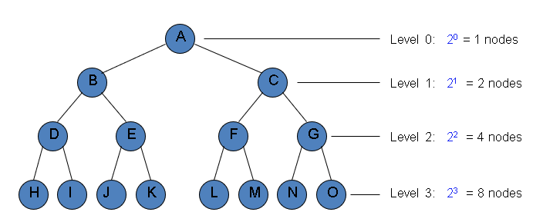
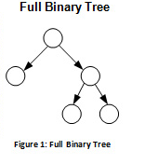
Full Binary Tree
each node of binary tree has either two children or no child at all, is said to be a Full Binary Tree.
Full binary tree is also called as Strictly Binary Tree.

Slide 44
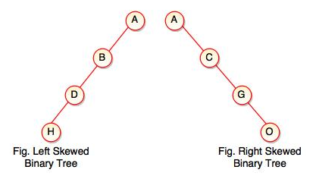
Skewed Binary Tree
If a tree which is dominated by left child node or right child node, is said to be a Skewed Binary Tree.
In a skewed binary tree, all nodes except one have only one child node. The remaining node has no child.

Slide 45
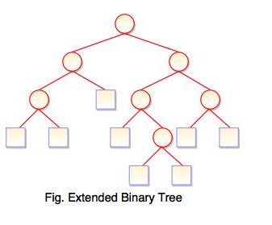
Extended Binary Tree
An external node is one without child branches, while an internal node has at least one child branch.
Extended binary tree is a type of binary tree in which all the null sub tree of the original tree are replaced with special nodes called external nodes whereas other nodes are called internal nodes
Every internal node in the extended binary tree has exactly two children and every external node is a leaf. It displays the result which is a complete binary tree.

Slide 46
Binary Search Tree(BST)
Is also a Binary Tree such that:
Every node entry has a unique key (i.e. no duplication item).
All the keys in the left subtree of a node are less than the key of the root node.
All the keys in the right subtree of a node are greater than the key of the root node.

Slide 47
Example 1:
key is an integer
43
31
64
20
40
56
89
28
33
47
59

Slide 48
Example 2:
key is a string
Fred
Dan
Mary
Alan
Eve
Kate
Sue
Bill
Eric
Greg
Len

Slide 49
Binary search tree construction algorithm:
Start with a tree containing just one Node (the root).
To add a new item, do the following until stop:
If item < root_item:
If root_item has a left child then move to the left (root_item = root_item_left) and repeat.
Else add a new left child with this item. Stop.
If item > root_item:
If root_item has a right child then move to the right (root_item = root_item_right).
Else add a new right child with this item. Stop.
Example : Make a BST with the following list.
5 9 8 1 2 4 6 10

Slide 50
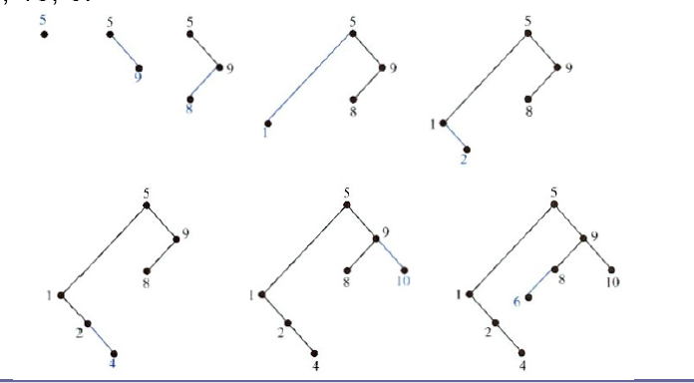
Example : Make a BST with the following list.
5 9 8 1 2 4 6 10

Slide 51
Exercises :
Construct a binary search tree for the words mathematics, physics, geography, zoology, meteorology, geology, psychology, and chemistry using alphabetical order.
Build a binary search tree for the words banana, peach, apple, pear, coconut, mango, and papaya using alphabetical order.

Slide 52
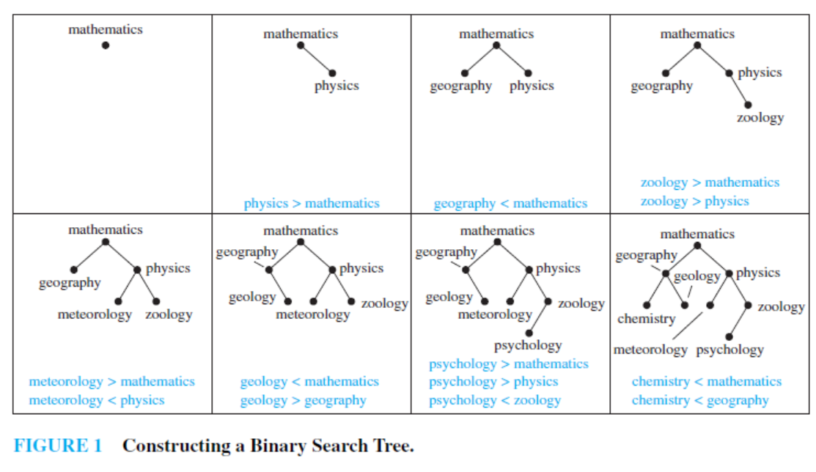
Answer 1:

Slide 53
Insert a node into a BST (example)
57
43
31
64
20
40
56
89
28
33
47
59

Slide 54
Insert (example )
57
43
31
64
20
40
56
89
28
33
47
59
57

Slide 55
Search: Checklist
if target key is less than current node’s key, search the left sub-tree.
else, if target key is greater than current node’s key, search the right sub-tree.
returns:
if found, pointer to node containing target key.
otherwise, NULL pointer.

Slide 56
Search
Example:
59
43
31
64
20
40
56
89
28
33
47
59
57
found
56

Slide 57
Search
Example:
61
43
31
64
20
40
56
89
28
33
47
59
57
failed

Slide 58
Traversal
Systematic way of visiting all the nodes.
Methods:
Inorder
Postorder
Preorder
They all traverse the left subtree before the right subtree.
The name of the traversal method depends on when the node is visited.

Slide 59
Inorder Traversal (Lfet_Node_Right)
Traverse the left subtree.
Visit the node.
Traverse the right subtree.
a
b
c
b
a
c

Slide 60
Inorder Example
a
b
c
f
d
e
g
j
h
i
g
d
h
b
e
i
a
f
j
c

Slide 61
Postorder Traversal (Lfet_Right_Node)
Traverse the left subtree.
Traverse the right subtree.
Visit the node.
a
b
c
b
c
a

Slide 62
Postorder Example
a
b
c
f
d
e
g
j
h
i
g
h
d
i
e
b
j
f
c
a

Slide 63
Preorder Traversal (Node_Lfet_Right)
Visit the node.
Traverse the left subtree.
Traverse the right subtree.
a
b
c
a
b
c

Slide 64
Preorder Example
a
b
c
f
d
e
g
j
h
i
a
b
d
g
h
e
i
c
f
j
Notes:
During the traversal, t starts at the root, moves to the left child b of the root, then to the left child d of b. When the traversal of the left subtree of b is complete, t, once again, points to the node b. The t moves into the right subtree of b. When the traversal of this right subtree is complete, t again points to b. Following this, t points to a. We see that t points to every node in the binary tree three times – once when you get to the node from its parent (or in the case of the root, t is initially at the root), once when you return from the left subtree of the node, and once when you return from the node’s right subtree. Of these three times that t points to a node, the node is visited the first time.

Slide 65
Some Examples
preorder = ab
a
a
b
b
inorder
= ab
b
a
a
b
postorder = ab
b
b
a
a

Slide 66
Exercise: Find the sequences for Preorder, Inorder and Postorder Traversal
a
d
b
c
e
i
g
f
h
j
k
l
m
n
o
p

Slide 67
Answer:
Preorder: a b e j k n o p f c d g l m h i
Inorder: j e n k o p b f a c l g m d h i
Postorder: j n o p k e f b c l m g h i d a

Slide 68
Example: Inorder
43
31
64
20
40
56
89
28
33
47
59
20
28
31
33
40
43
47
56
59
64
89

Slide 69
Example: Postorder
43
31
64
20
40
56
89
28
33
47
59
28
20
33
40
31
47
59
56
89
64
43

Slide 70
Example: Preorder
43
31
64
20
40
56
89
28
33
47
59
43
31
20
28
40
33
64
56
47
59
89

Slide 71
Deleting a node in BST
As is common with many data structures, the hardest operation is deletion.
Once we have found the node to be deleted, we need to consider several possibilities.
If the node is a leaf, it can be deleted immediately.
If the node has one child, the node can be deleted after its parent adjusts a pointer to bypass the node and connect to inorder successor.
The complicated case is when the node to be deleted has both left and right subtrees. The strategy is to replace the data of this node with the smallest data of the right subtree and recursively delete that node.

Slide 72
Example of BST
43
Two child
31
Two child
64
Two child
One child
Two child
20
One child
40
56
89
Leaf
28
33
Leaf
47
59
Leaf
Leaf
Leaf

Slide 73
1. Deleted node 33 (node is a leaf)
43
31
64
20
40
56
89
28
Leaf node
47
59

Slide 74
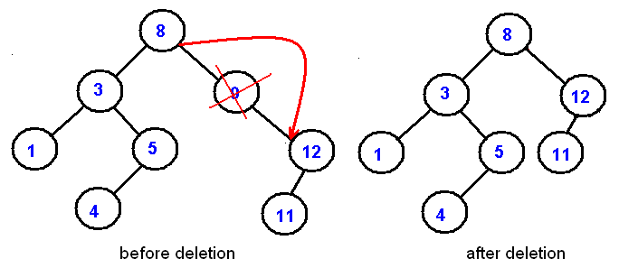
2. Deleted node 9 (node has one child)
this node can be deleted after its parent adjusts a pointer to bypass the node and connect to inorder successor.
(Inorder successor of a node is the next node in Inorder traversal of the Binary Tree.)

Slide 75
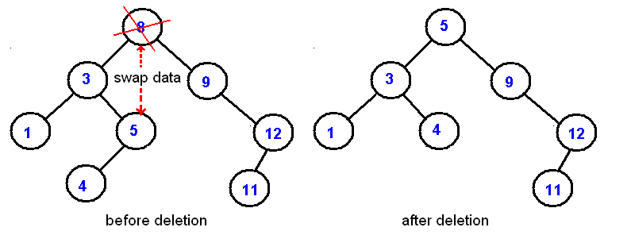
3. Deleted node 31 (node has both left and right subtrees)
The strategy is to replace the data of this node with the smallest/largest data of the right/left subtree and recursively delete that node.
and delete this node

Slide 76
Binary Tree implementation by linked list
entry
link to right
child node
link to left
child node

Slide 77
Data type of a Tree Node
struct TreeNode
{
float key;
TreeNode* leftPtr;
TreeNode* rightPtr;
};
struct TreeNode TNode;

Slide 78
TreeNode* makeTreeNode(float value) { TreeNode* newNodePtr = new (TreeNode); if (newNodePtr == NULL) { cout<< "Out of memory; return 0; } else { newNodePtr->key = value; newNodePtr->leftPtr = NULL; newNodePtr->rightPtr = NULL; } return newNodePtr; }

Slide 79
TreeNode* insert(TreeNode* nodePtr, float item) { if (nodePtr == NULL) { nodePtr = makeTreeNode(item); } else if (item < nodePtr->key) { nodePtr->leftPtr = insert(nodePtr->leftPtr, item); } else if (item > nodePtr->key) { nodePtr->rightPtr = insert(nodePtr->rightPtr, item); } return nodePtr; }

Slide 80
Function Call to Insert
/* …other bits of code omitted… */
cout<<“Enter number of items ”;
cin>>n;
for (i = 0; i < n; i++) {
cin>>item;
rootPtr = insert(rootPtr, item);
}
/* …and so on… */

Slide 81
TreeNode* search(TreeNode* nodePtr, float target) { if (nodePtr != NULL) { if (target < nodePtr->key) { nodePtr = search(nodePtr->leftPtr, target); } else if (target > nodePtr->key) { nodePtr = search(nodePtr->rightPtr, target); } } return nodePtr; }

Slide 82
Function Call to Search
/* …other bits of code omitted… */
cout<<“Enter target ”;
cin>>item;
TreeNode* itemptr= search(rootptr, item);
if (itemptr == NULL)
{
cout<<“Item was not found”;
}
else
{
cout<<“Item found\n”;
}
/* …and so on… */

Slide 83
Inorder Traversal (recursive version)
A / B * C * D + E
void inorder(TreeNode ptr)
{
if (ptr!=NULL) {
inorder(ptr->left_child);
cout << ptr->key;
indorder(ptr->right_child);
}
}
+
*
E
*
D
/
C
A
B

Slide 84
Postorder Traversal (recursive version)
A B / C * D * E +
void postorder(TreeNode ptr)
{
if (ptr!=NULL) {
postorder(ptr->left_child);
postdorder(ptr->right_child);
cout << ptr->key;
}
}
+
*
E
*
D
/
C
A
B

Slide 85
Preorder Traversal (recursive version)
+ * * / A B C D E
void preorder(TreeNode ptr)
{
if (ptr!=NULL) {
cout << ptr->key;
preorder(ptr->left_child);
predorder(ptr->right_child);
}
}
+
*
E
*
D
/
C
A
B

Slide 86
An array implementation of a Complete Binary Tree:
Number the nodes (starting at 0) by levels, from top to bottom and left to right within level
0
1
2
3
4
5
6
Parent to children (index i to 2i+1, 2i+2)
0 1 2 3 4 5 6 ……
Root
Level 1 nodes
Level 2 nodes

Slide 87
Binary Tree Representations
If a complete binary tree with n nodes (depth = log n + 1) is represented sequentially, then for any node with index i, 0<=i<=n-1, we have:
parent(i) is at ⎣(i-1)/2 ⎦ if i!=0.
If i=0, i is at the root and has no parent.
leftChild(i) is at 2i+1 if 2i+1<=n.
If 2i+1>n, then i has no left child.
rightChild(i) is at 2i+2 if 2i+2 <=n.
If 2i +2>n, then i has no right child.

Slide 88
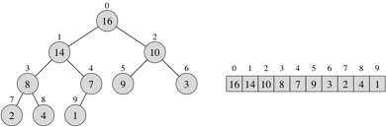
Binary Tree as an array
Parent left Child righ Child
i 2i+1 2i+2
⎣(i-1)/2⎦ i

Slide 89
Inorder Traversal (recursive version)
A / B * C * D + E
void inorder(int i)
{
if (i!=NULL) {
inorder(2xi+1);
cout << Tree[i];
indorder(2xi+2);
}
}
+
*
E
*
D
/
C
A
B

Slide 90
Postorder Traversal (recursive version)
A B / C * D * E +
void postorder(int i)
{
if (i!=NULL) {
postorder(2xi+1);
postdorder(2xi+2);
cout << Tree[i];
}
}
+
*
E
*
D
/
C
A
B

Slide 91
Preorder Traversal (recursive version)
+ * * / A B C D E
void preorder(int i)
{
if (i!=NULL) {
cout << Tree[i];
preorder(2xi+1);
predorder(2xi+2);
}
}
+
*
E
*
D
/
C
A
B

Slide 92
References
https://www.geeksforgeeks.org/types-of-trees-in-data-structures/

